Slide 1
[TP1] Planetary Dynamics: Shape, Gravity, Orbit, Tides, and Rotation from Observations and Models (this is an example)
Co-organized by OPS/SB
Conveners: Alexander Stark | Co-conveners: Hannah Susorney, Anton Ermakov, Marie Yseboodt
Thu, 16 Sep, 10:40–11:25 (CEST)

Slide 2
Housekeeping slide
Please mute yourself when you are not presenting. Please also put your phone in silence mode.
The session is being recorded.
Please ask your questions in the Zoom chat. A dedicated time for discussions will follow the live pitch presentations.
Any question that is not answered live will be also asked on Slack. We encourage you to continue the discussion there after the session, at epsc2021.slack.com.

Slide 3
Introduction from the Chair(s)
The conveners will introduce their session as they see fit.
The conveners should be mindful to allocate enough time during the session to go over all live pitches from the presenters (1 min per presenter + ~30 sec between presenters) as well as schedule some time for discussion at the end of the session.
The participants should ask questions directly in the Zoom chat during the session, and they be discussed at the end of the session.
Note: if the session is split over multiple time blocks, the conveners are encouraged to reproduce the same format over the different time blocks (introduction, live pitches and Q&A / discussion).

Slide 4
Live Pitches – if the authors uploaded a pitch slide
The conveners should insert the slide provided (3 slides for solicited presentation).
The author will present their 1-min live pitch during the session (3 min for solicited presentation).

Slide 5
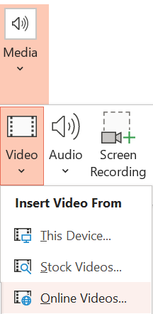
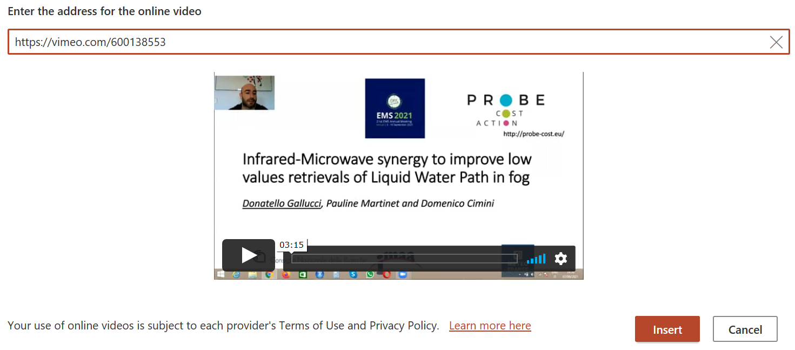
Live Pitches – if the authors uploaded a pitch video
The conveners should insert the video provided by the author, using the link on Vimeo.
To do so (in PowerPoint), select Insert > Media > Video > Online Videos, indicate the link for the video on Vimeo (https://vimeo.com/...) and click on Insert.
The conveners will play the video during the session.

Slide 6
Live Pitches – if the authors did not upload anything
Abstract Title
List of authors (presenting author in bold)
Short summary of the abstract + any figures included in the abstract.
If the presentation is public, the conveners can also extract graphics and information from the presentation.
However, if the presentation is marked as private ( icon on the presentation thumbnail), the convener should NOT use any of its content for the live pitch.
If the author is present during the session, he/she will be able to provide their 1-min live pitch (3-min for a solicited presentation).

Slide 7
Q&A – Discussion
At the end of the session, the conveners will go over any questions asked in the chat during the session and moderate the discussion.
The conveners should favor cross-cutting questions during the live Q&A over questions on specific presentations that should rather be discussed on Slack.
The conveners should post any questions that was not answered live on Slack at the end of the Q&A.
Finally, the conveners should remind all participants to continue the discussion on Slack after the session.

Slide 8
COFFEE BREAK
Now is time to take a break!
Chill out and discuss in the EPSC2021 social room at:
http://tiny.cc/epsc2021

